Slide 1

INTERNSHIP REPORT
UNDER SUPERVISION OF
DR. ANKIT RAJPAL
ASSISTANT PROFESSOR
SUBMITTED BY
SATYAM SAHU
DEPARTMENT OF COMPUTER SCIENCE
UNIVERSITY OF DELHI
2024-2025

Slide 2
GENERATIVE AI

Slide 3

ABOUT THE COMPANY
Ciena Corporation is an American telecommunications company recognized as a leading global provider of networking equipment, software, and services.
Renowned for its expertise in optical connectivity, Ciena dominates the global market as the largest provider of network elements (NE), software, and services, primarily catering to the telecommunications industry.

Slide 4
PRODUCTS AND SERVICES
Converged Packet Optical
Routing and Switching
Network Control and Management Software
Intelligent Automation Solutions
Waveserver
6500 Plateform
5400 Series
3000 Series
5000 Series
6500 Packet Transport System
Service-Aware Operating System (SAOS)
Navigator NCS
Planner Plus
Emulation Cloud
Intelligent Control Plane
Blue Planet Route Optimization and Assurance
Blue Planet vWAN
Blue Planet Services
Blue Planet Open Network Operating System
Blue Planet NFV Orchestration
Blue Planet Analytics
Blue Planet Multi-domain Service Orchestration

Slide 5
ROLE
OF NAVIGATOR
NETWORK
CONTROL
SUITE
Ciena’s Network management system Navigator NCS (Navigator Network Control Suite) is a Linux-based server software for managing Ciena network elements (NEs).
NE management tasks include monitoring alarm conditions on NEs, backing up and restoring NE software, and upgrading NE software.
Navigator NCS also manages multi-layer packet and optical services. It provides a real-time view of network and service topology.

Slide 6

TEAM INTRODUCTION
During my internship, I worked with the Core-AI-Dev team.
The tasks were assigned by Mr. Neeraj Shrivastava, Senior Manager, Software Engineering Systems.
Mr. Varun Aggarwal was assigned as my buddy to assist me with any queries or support needed.

Slide 7

PROBLEM DESCRIPTION
During my internship, I was assigned multiple tasks such as bug fixing, writing automation scripts, testing documentation, and conducting proof of concept (PoC) activities on open-source tools like DSPy and TextGrad.
My primary responsibility was to design the backend for Ciena’s upcoming product, MCP-Chatbot (a conversational chatbot) in the most optimized way possible.

Slide 8
SOLUTION
Technique
Open Source Tools
Large Language Model
RAG (retrieval-augmented generation)
all-MiniLM-L6-v2 – Embedding model
Qdrant - A vector database
pymupdf4llm - Pdf parser
GPT-4o
GPT-4o-mini
Gemini 2.0

Slide 9
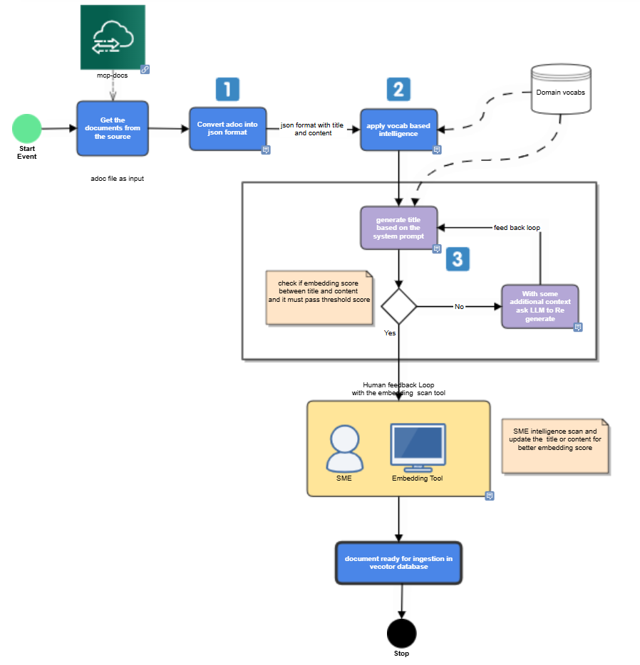
IMPLEMENTATION
(Doc Preprocessing)

Slide 10
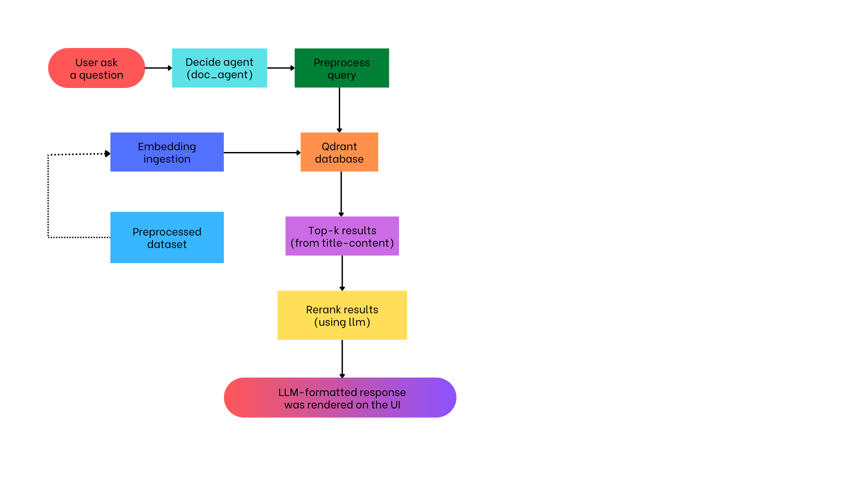
IMPLEMENTATION
(Workflow)

Slide 11

CONCLUSION
Building on the foundation of the conversational chatbot, several areas of future work can further enhance its capabilities and performance.
Implementing advanced algorithms and standardized techniques will contribute to improved accuracy and efficiency.
Moreover, continuous performance optimizations will ensure the chatbot can effectively scale and handle an increasing volume of customer queries.

Slide 12
https://en.wikipedia.org/w/index.php?title=Ciena&oldid=1143238034
https://www.ciena.com/about
https://www.ciena.com/products/converged-packet-optical
https://www.ciena.com/products/routing-switching
https://www.ciena.com/products/domain-control-management-software
https://qdrant.tech/
https://aws.amazon.com/what-is/retrieval-augmented-generation/
https://huggingface.co/sentence-transformers/all-MiniLM-L6-v2
https://azure.microsoft.com/en-us/get-started/azure-portal/?msockid=3f3b5d42518e63d112de49fa507c622f
REFERENCE
LINKS

Slide 13
THANK YOU

